Slide 1
Normal Distribution

Slide 2
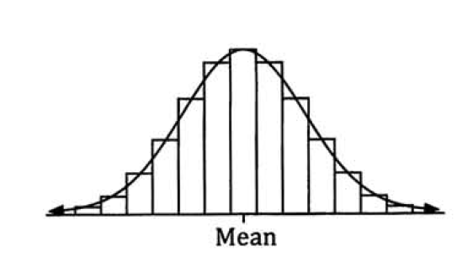
Bell shaped curve
Normal Distribution

Slide 3
The normal distribution
Also known as Gaussian distribution
mean = median = mode
symmetry about the centre
50% of values less than the mean and 50% greater than the mean
Notes:
https://www.mathsisfun.com/data/standard-normal-distribution.html

Slide 5
68%, 95%, 99.7% RULE
3sd
2sd
1sd
Mean
1sd
2sd
3sd

Slide 6
What does it mean?
68.3% of data values are within 1 standard deviation of the mean
Probability of a randomly chosen data point within 1σ = 68.3%
95.4% of data values are within 2 standard deviations of the mean
Probability of a randomly chosen data point within 2σ = 95.4%
99.7% of data values are within 3 standard deviations of the mean
Probability of a randomly chosen data point within 3σ = 99.7%
Notes:
http://www.investopedia.com/articles/active-trading/092914/normal-distribution-table-explained.asp

Slide 7
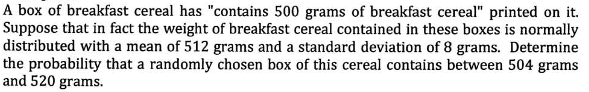
Example 1

Slide 8
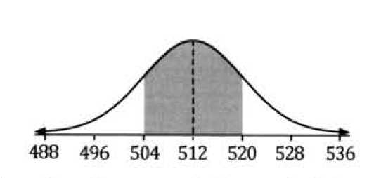

Slide 9
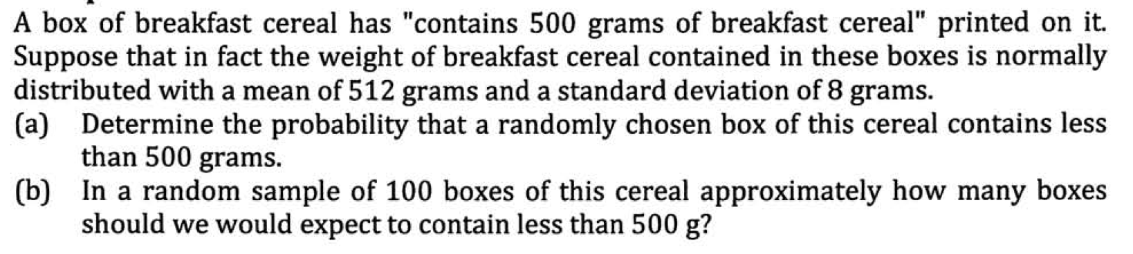
Example 2

Slide 10
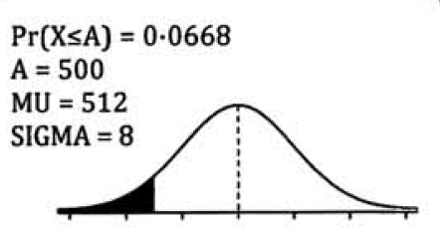
488
496
504
512
520
528
536

Slide 11
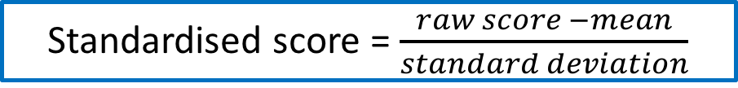
Standardised score = $\frac{raw score −mean}{standard deviation}$

Slide 13
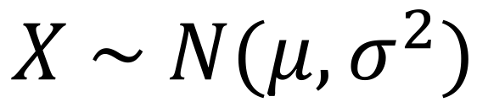
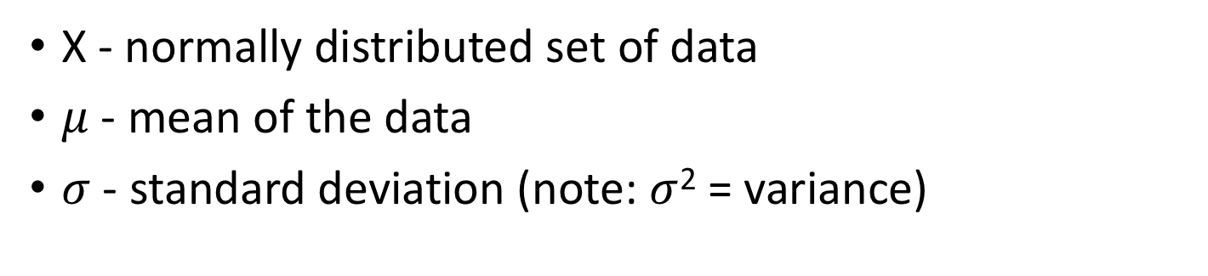
Notation
$$X \sim N(μ,σ^{2})$$
X - normally distributed set of data
$μ$ - mean of the data
$σ$ - standard deviation (note: $σ$² = variance)

Slide 14
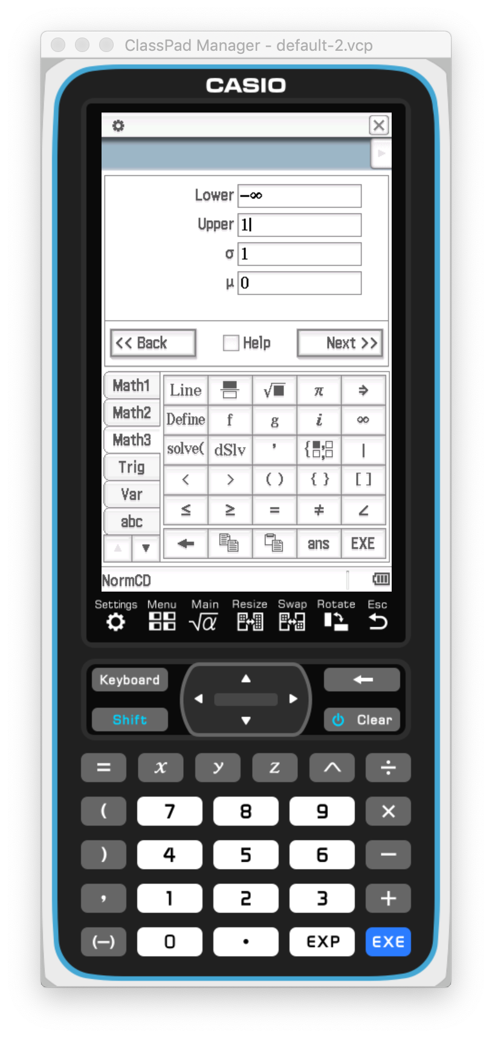
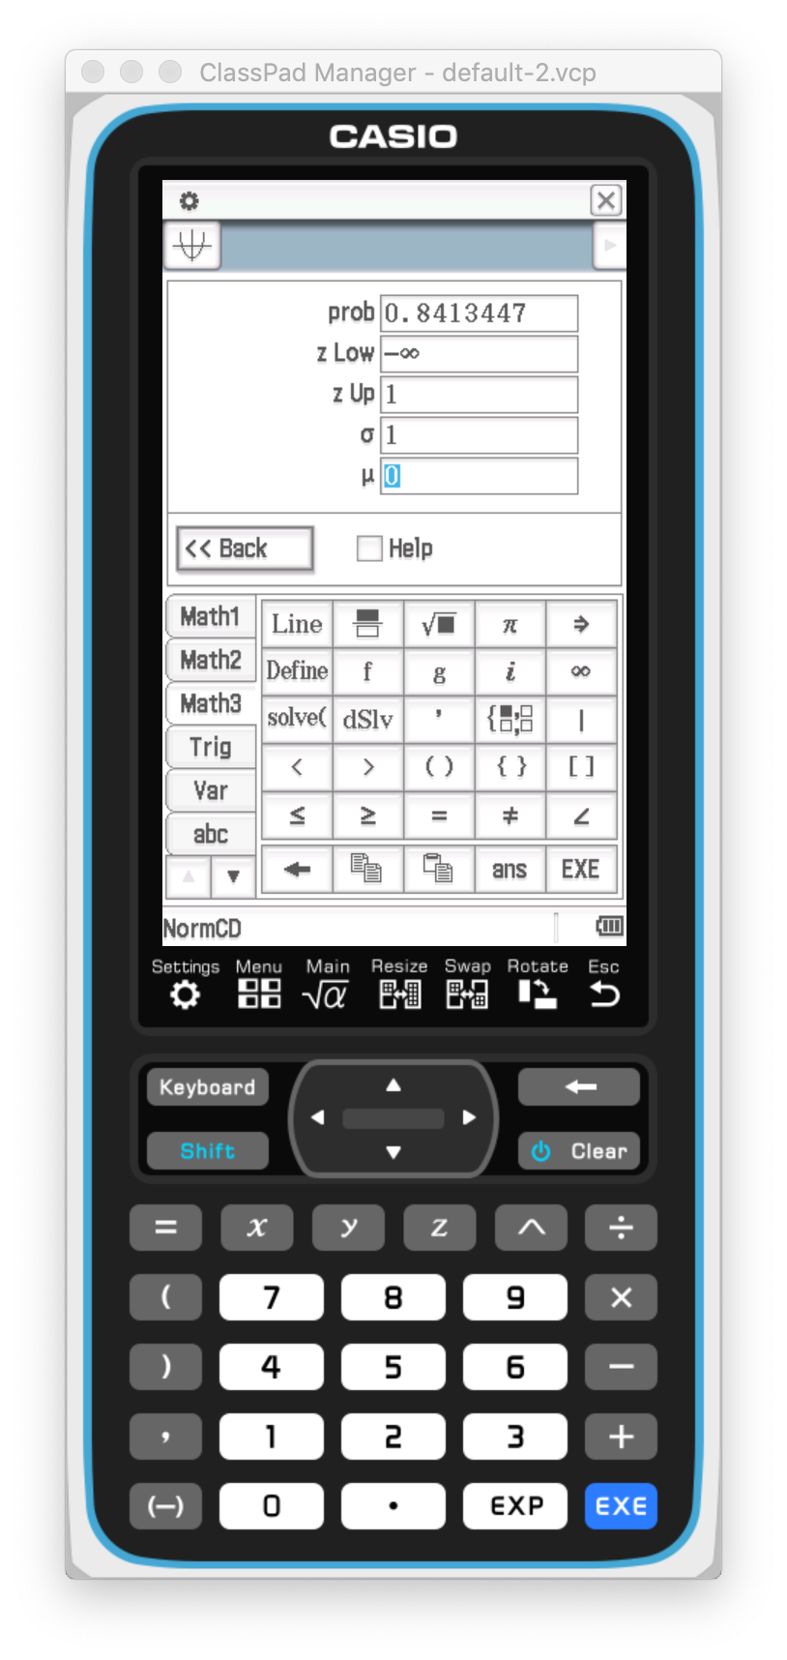
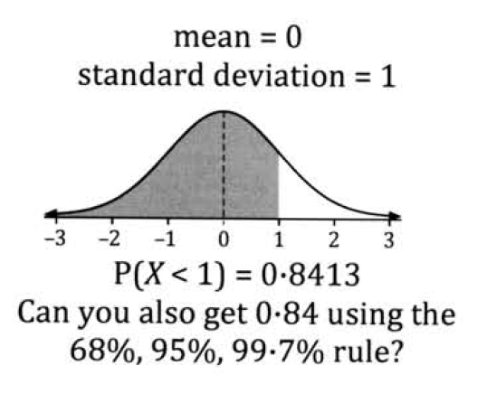

Slide 15
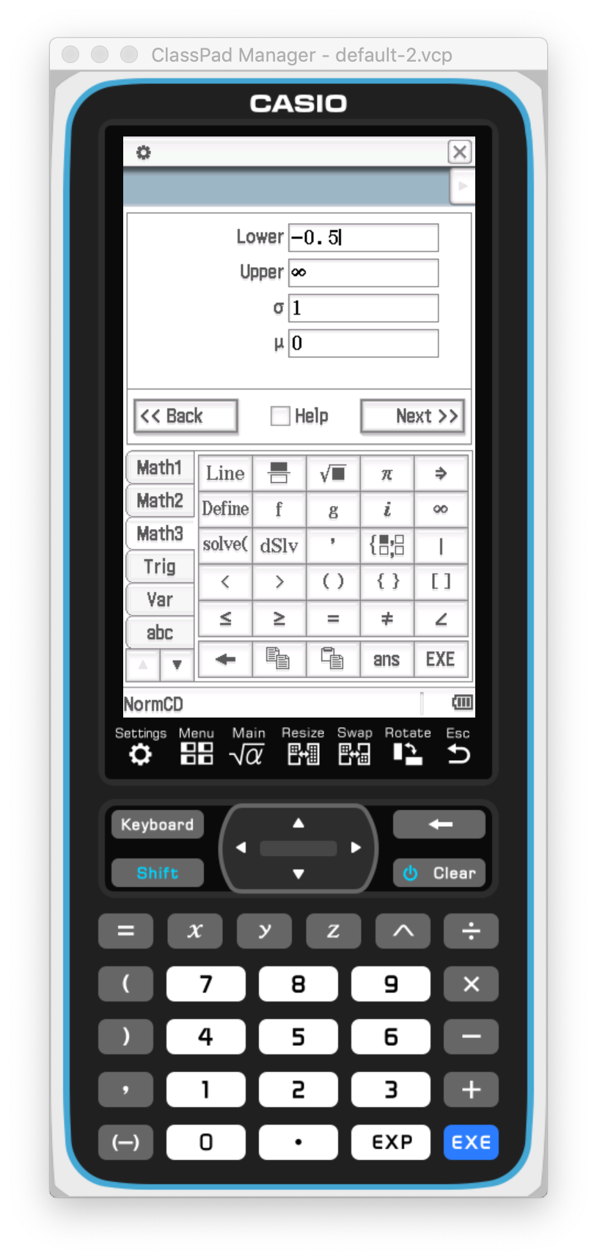
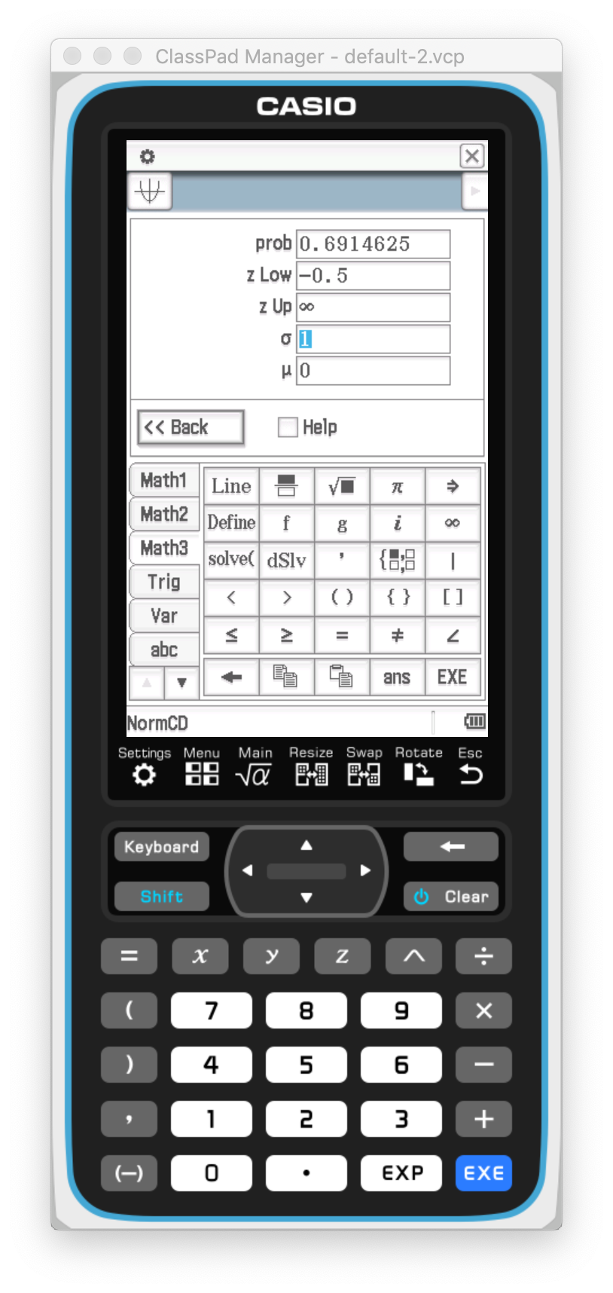
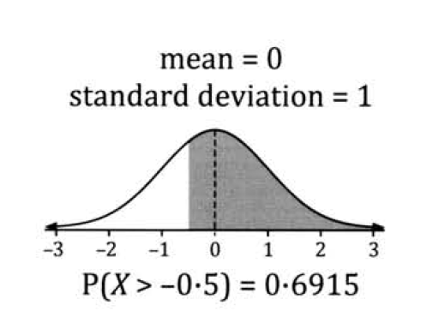

Slide 16
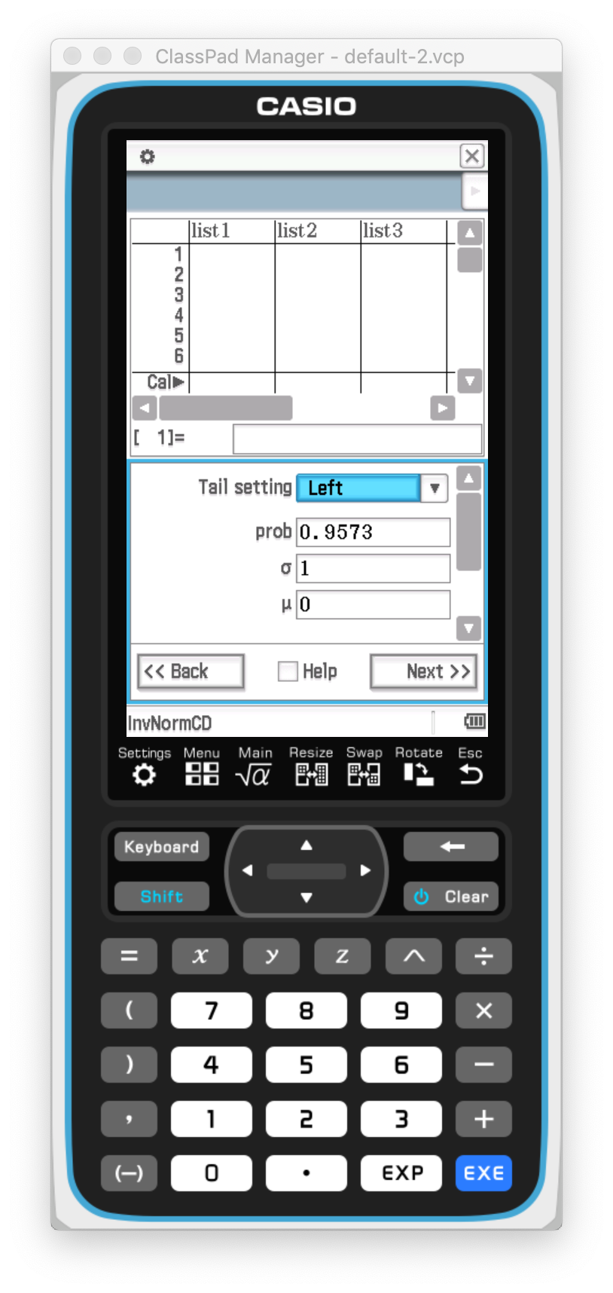
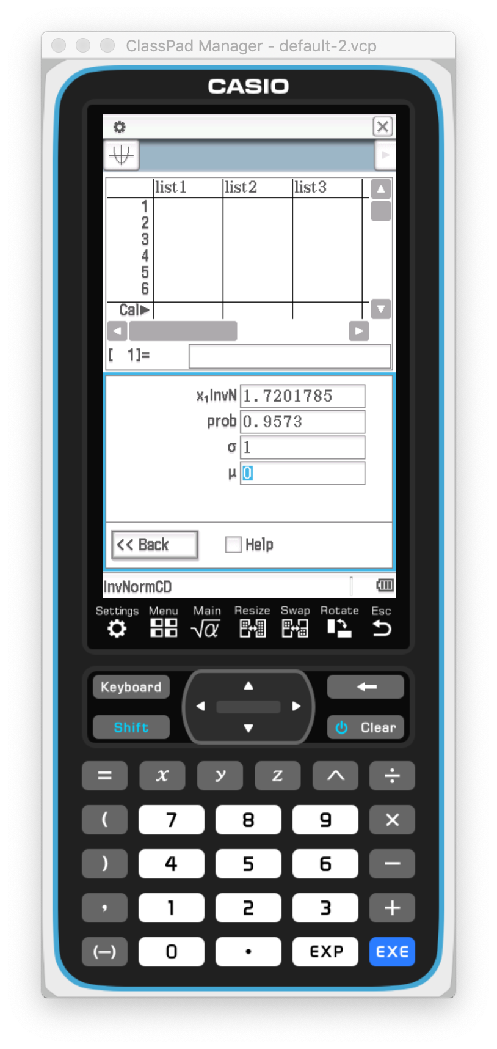
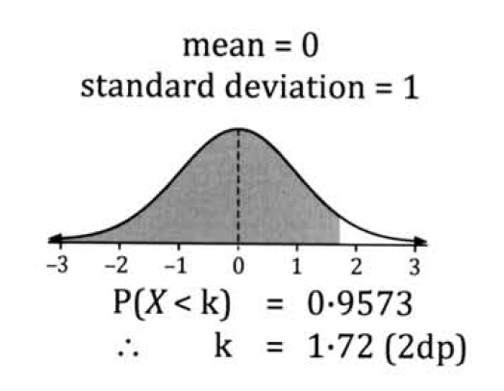
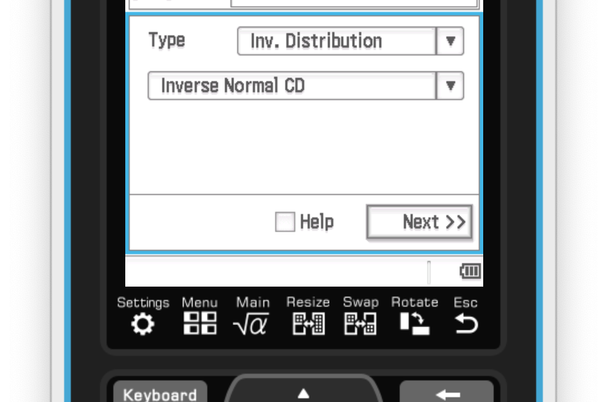

Slide 17
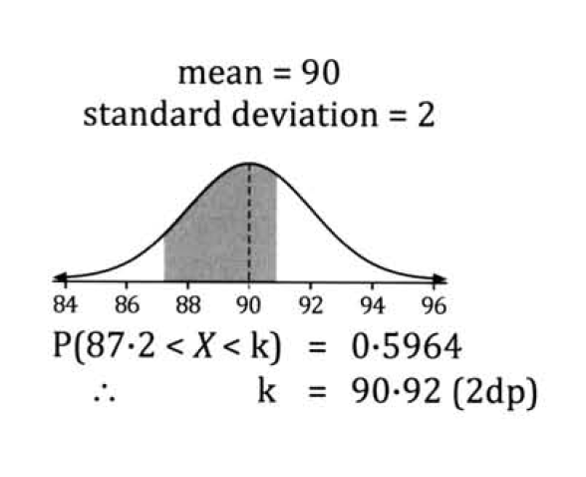
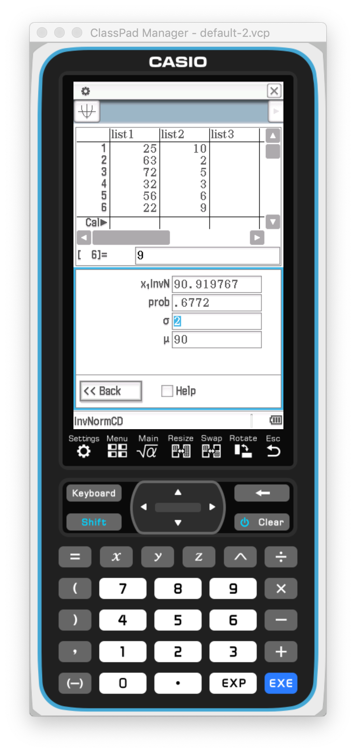
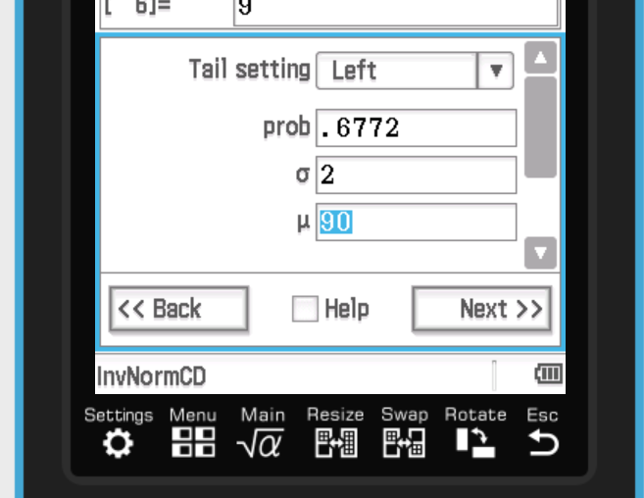
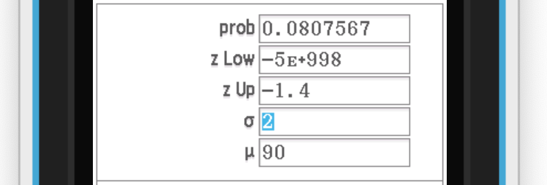
Step 2: Add the two probabilities together to determine P(X < K)
0.5964 + 0.0808 = 0.6772
Step 3: Use Inverse Distribution to find K
Step 1: Find the P(X > 87.2) using your class pad

